Slide 1
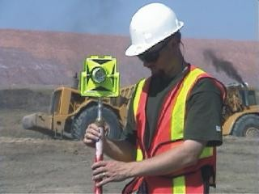
CHAPTER 7
Total Station Surveying
CE 316
March 2012
249

Slide 2
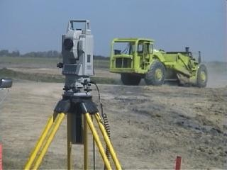
7.1 Introduction
Total station surveying - defined as the use of electronic survey equipment used to perform horizontal and vertical measurements in reference to a grid system (e.g. UTM, mine grid).

Slide 3
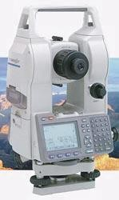
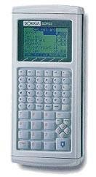
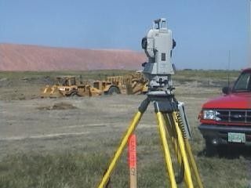
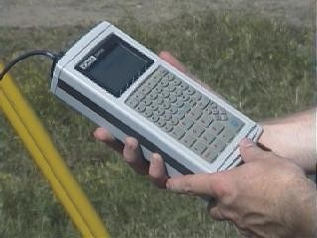
7.2 Components Used in Total Station Surveying
1) Total Station (and tripod)
2) Electronic Notebook

Slide 4
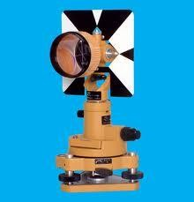
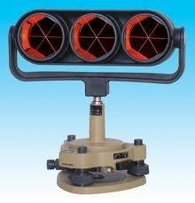
7.2 Components Used in Total Station Surveying
3) Prism (and prism pole)

Slide 5
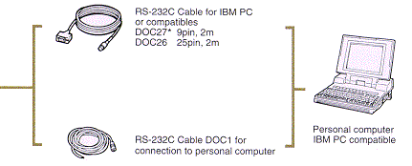
7.2 Components Used in Total Station Surveying
Computer interface
Batteries and radios

Slide 6
7.3 Types of Total Station Surveying
Slope Staking
Topographic surveys
Construction project layout
building corners
control and offset lines
Leveling
Traverse surveys and adjustments
Building Face Surveys
Resections
Areas
Intersections
Point Projections
Road (Highway) Surveys
Taping from Baseline

Slide 7
7.4 Advantages of Total Station Surveying
Relatively quick collection of information
Multiple surveys can be performed at one set-up location.
Easy to perform distance and horizontal measurements with simultaneous calculation of project coordinates (Northings, Eastings, and Elevations).
Layout of construction site quickly and efficiently.
Digital design data from CAD programs can be uploaded to data collector.
Daily survey information can also be quickly downloaded into CAD which eliminates data manipulation time required using conventional survey techniques.

Slide 8
7.5 Disadvantages of Total Station Surveying
Vertical elevation accuracy not as accurate as using conventional survey level and rod technique.
Horizontal coordinates are calculated on a rectangular grid system. However, the real world should be based on a spheroid and rectangular coordinates must be transformed to geographic coordinates if projects are large scale.
Examples : highways, large buildings, etc.
As with any computer-based application “Garbage in equals Garbage out”. However, in the case of inaccurate construction surveys “Garbage in equals lawsuits and contractors claims for extras.”

Slide 9
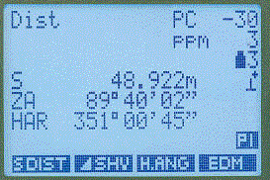
7.6 Total Station
A form of an electronic theodolite combined with an electronic distance measuring device (EDM).
the primary function is to measure slope distance, vertical angle, and horizontal angle from a setup point to a foresight point.
most total stations use a modulated near-infrared light emitting diode which sends a beam from the instrument to a prism. The prism reflects this beam back to the instrument. The portion of the wavelength that leaves the instrument and returns is assessed and calculated. Distance measurements can be related to this
measurement.
257

Slide 10
7.6 Total Station
the accuracy of a total station is dependent on instrument type.
Angle Accuracy (Horizontal or Vertical) can range from 2” to 5”.
Distance Accuracy can range from:
+/- (0.8 + 1 ppm x D) mm to +/- (3 + 3 ppm x D) mm
where D = distance measured
Accuracy is highly dependent on leveling the instrument. Thus two leveling bubbles are provided on the instrument and are referred to the circular level and the plate level. Circular level is located on the tribrack while plate level is on horizontal axis of instrument just below scope of the total station.
Sensitivity of Circular Level = 10’ / 2mm
Sensitivity of Plate Level = 30” / 2mm
258

Slide 11
7.7 Electronic Notebook
the “brains” of the total station. The notebook will record, calculate, and even manipulate field data automatically saving valuable time and manpower.
the electronic notebook records the slope distance, horizontal and vertical angles from the total station and can perform numerous calculations using operating software which is loaded into the unit.
SDR 33 is an electronic notebook made by Sokkia. Cost is approximately $4000 and can store up 2MB of readings and analysis.
the main menu of the notebook is made up of a number of directories:
Function menu
Survey menu
COGO menu
Road menu
Level menu
259

Slide 12
7.7 Electronic Notebook
7.7.1 Function Menu
the function menu consists of a series of sub-menus which contain specific input options which may be used during on particular job or may apply to all survey jobs.
the function sub-menus in the SDR 33 are:
Job - multiple jobs can be stored
Instrument type - instrument type, prism constant, orientation (azimuth)
Job settings - current job, atmospheric correction, curvature and
refraction correction, and sea level correction
Configure reading - allows control over how information can be numbered and stored (POS or OBS), single/double angle measurement setting, allows code lists to be activated, as well as compatibility with other instruments (WILD)
Tolerances - Hor. And Ver. Angle = 30”, EDM = 5mm allows accuracy
of duplicate readings to be checked.
260

Slide 13
7.7 Electronic Notebook
7.7.1 Function Menu
Units
Communications - downloading or uploading data (SDR, MOSS, DXF)
Date and Time
Job Deletion
Calculator
Feature Code List - list to identify survey details
Hardware - system info, battery life
Upgrade
User Program - allows programs to be uploaded
15) Language - English but you can upload more languages
261

Slide 14
7.7 Electronic Notebook
7.7.2 Survey Menu
the survey menu consists of a series of sub-menus which contain specific software to use the raw data recorded from the total station and transform this information into usable survey results.
the survey sub-menus in the SDR 33 are:
Topography - allows topography of a region to be measured.
2) Traverse Adjustment - allows series of stations used as traverse to be calculated for closure. The program can then calculate the adjustments required in the stations to ensure closure.
262

Slide 15
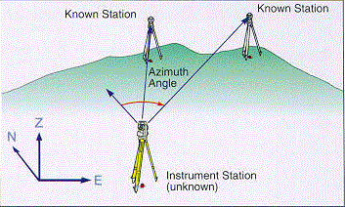
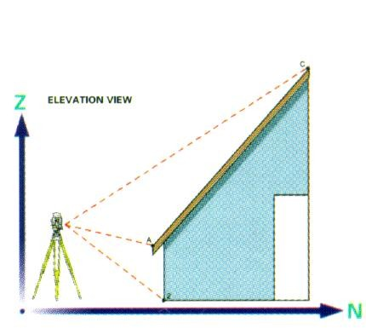
7.7 Electronic Notebook
7.7.2 Survey Menu
3) Resection - calculates the coordinates of an unknown or free station by observing a number of unknown stations from the unknown point.
4) Set Collection, Set Review - structured method for collecting multiple sets of information from a station.
5) Building Face Survey - used to survey details of a building including details where the prism cannot be placed.

Slide 16
7.7 Electronic Notebook
7.7.2 Survey Menu
Collimation - used to measure error in single angle measurements.
Remote Elevation - used to measure elevations of points in which the target can’t be placed. (e.g.. Powerline heights, bridge heights). The prism is placed directly below the object and the slope distance to the prism is recorded along with the angle up to the remote elevation. Based on these measurements, the remote elevation point can be calculated.

Slide 17
7.7 Electronic Notebook
7.7.3 COGO Menu
COGO is a suite of programs aimed at coordinate geometry problems in civil engineering – originally a subsystem of MIT’s Integrated Engineering System (ICES) developed in the 1960’s.
the COGO menu consists of a series of sub-menus which contain specific software used for coordinate geometry calculations and setting out work in the field.
the COGO sub-menus in the SDR 33 are:
1) Setting out Coordinates - allows coordinates to be placed in the field.

Slide 18
7.7 Electronic Notebook
7.7.3 COGO Menu
Setting out Line
Set out Arc
Resection
Inverse - allows calculation of point to point info,
Areas
Intersections
Point Projections
Taping from Baseline

Slide 19
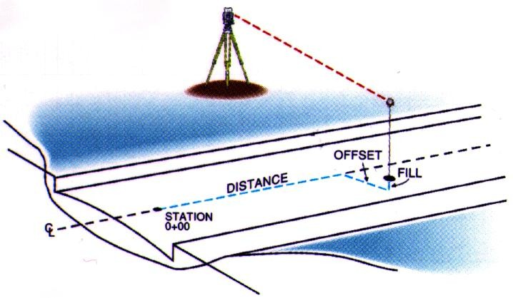
7.7 Electronic Notebook
7.7.4 Road Menu
the Road menu consists of a series of sub-menus which contain specific software used to perform a detailed road or highway survey.
the details of the road can be entered into the data collector and the road can be laid out in the field including all appropriate cut and fill information at each point.
the cross-section survey sub-menu allows for measurements of earthwork areas which can be uploaded into CAD for earthwork volume calculations.

Slide 20
7.7 Electronic Notebook
7.7.5 Level Menu
The level menu consists of a series of sub-menus which contain specific software used to perform a levelling and level adjustment calculations

Slide 21
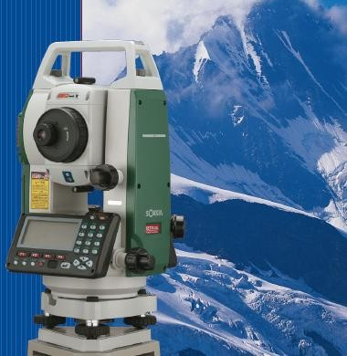
7.8 Reflectorless Total Stations
The level menu consists of a series of sub-menus which contain specific software used to perform a levelling and level adjustment calculations
http://www.youtube.com/watch?v=jGD27_9SFso

Slide 22
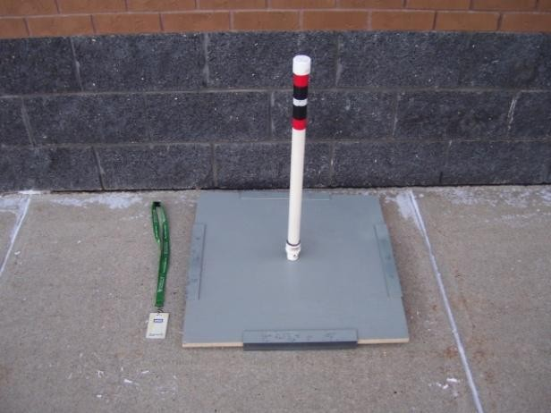
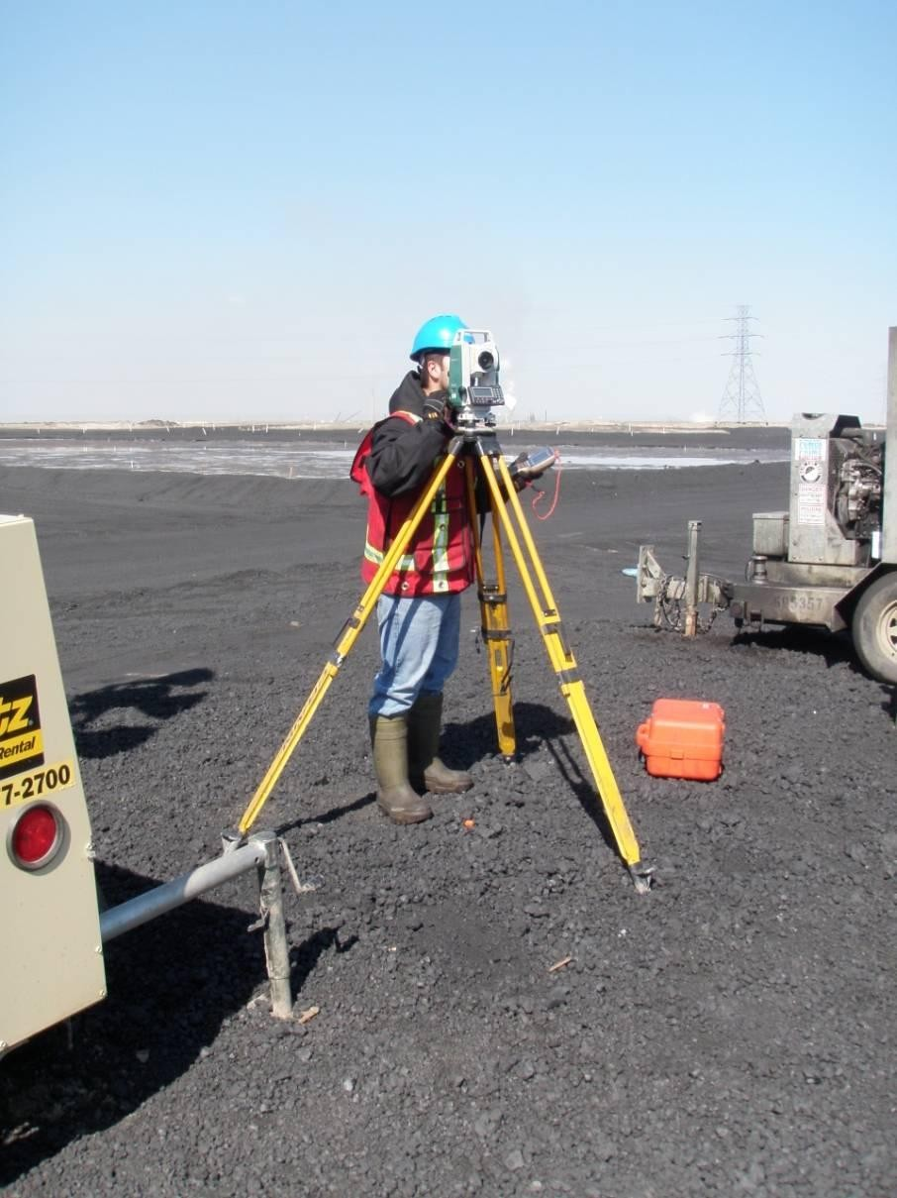
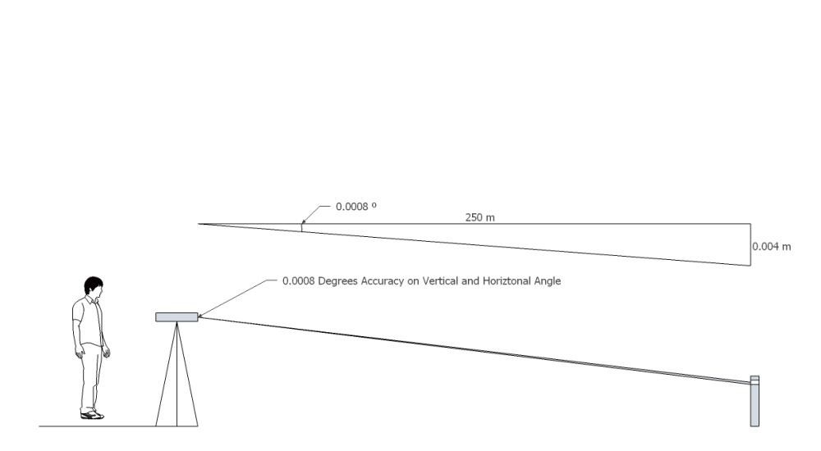
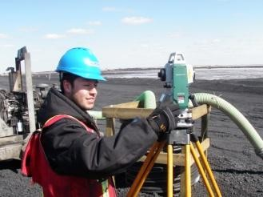
7.8 Reflectorless Total Stations
Case History

Slide 23
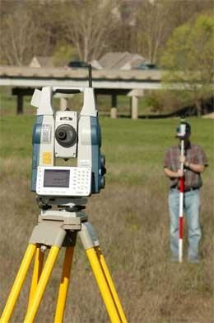
7.9 Robotic Total Stations
7.9.1 Sokkia SRX
The level menu consists of a series of sub-menus which contain specific software used to perform a levelling and level adjustment calculations
http://www.youtube.com/watch?v=QrmQdyplP4k&feature=related
271

Slide 24
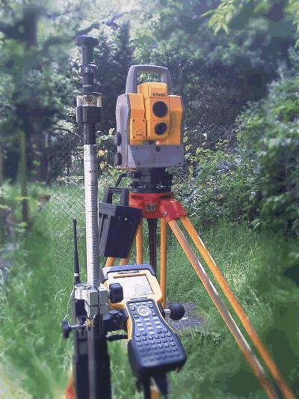
7.9 Robotic Total Stations
7.9.2 Topcon
http://www.youtube.com/watch?v=sT70bSf7PE8
272

Slide 25
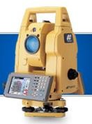
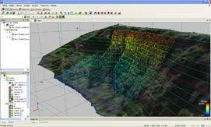
7.10 Digital Photographic Imaging
7.10.1 Topcon
Topcon's GPT-7000i is a World's First imaging total station. It contains an integrated camera that allows you to visually map measurements to job site photographs. With additional software you can create 3D point clouds and stereoscopic images.
Pinpoint reflectorless measuring up to 250m Single prism measuring up to 3000m
GPT-7000i
http://www.youtube.com/watch?v=72JmJKJaUhU&feature=related
273

Slide 26
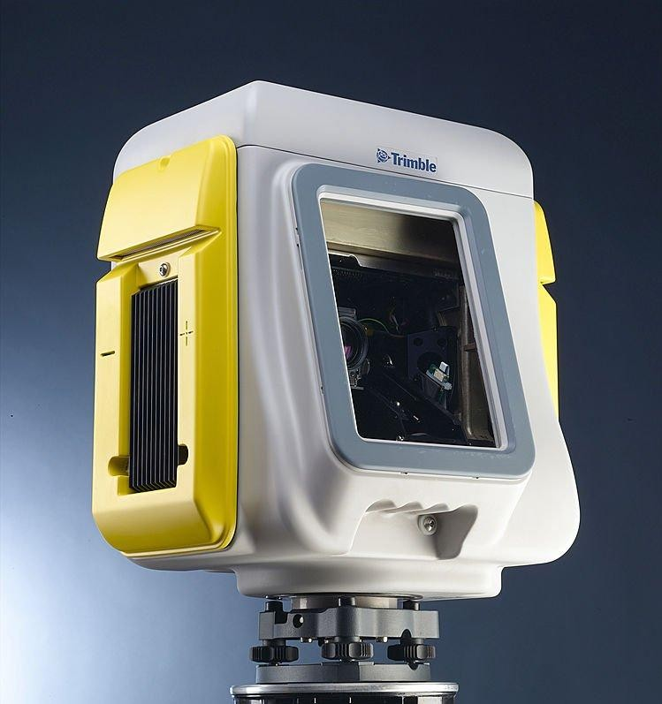
7.11 Spatial Imaging
7.11.1 Trimble
Trimble GX 3D Scanner
http://www.youtube.com/watch?v=uFWFjF9sR44&feature=related
274

Slide 27
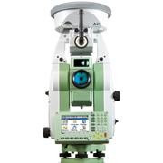
7.12 GPS TOTAL STATIONS
Leica SmartStation
Total Station with integrated GNSS/GPS
World’s first, TPS and GPS perfectly combined. High performance total station with powerful GNSS/GPS receiver. No need for control points, long traverses or resections. Just set up SmartStation and let GNSS/GPS determine the position. You survey easier, quicker and with fewer set ups.
275

Slide 28
7.13 RTK Positioning
Real Time Kinematic
Based on the use of carrier phase (GPS, Glonass, Galileo, etc.)
Normal – compare pseudorandom signal from satellite to internally generated copy of the same signal.
Since they do not line up properly, by delaying local signal more and more they eventually line up.
Delay is time need for the satellite to reach the receiver.
Accuracy is approx. 1% of band with (i.e. C/A code send bit every 0.96 microsecond (3m).
Other C/A signal errors can add up to approx. 15 m.
RTK same concept, but uses much smaller wavelength carrier signals, not messages within.
L1 Carrier 1.023 MHz – l = 0.19m, thus + = 1.9 mm.
Resolution of integer ambiguity requires sophisticated statistical software and access to multiple satellites.
RTK single base station receiver – re-broadcast signals it receives to a number of mobile receivers (UHF most popular).
Typical accuracy of dual frequency systems: 1 cm 2ppm horizontally
2 cm 2ppm vertically
276

